Slide 1
Lecture 10 - Microservices

Slide 2



‘Microservices’?
*

Slide 3
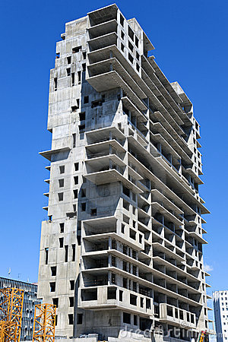
‘Monolithic’ Architecture
*

Slide 4
Monolithic Architecture
All functionalities are implemented/deployed into a single software application.
Enterprise software applications - ERPs, CRMs etc.
SOA/web services: 'coarse-grained' services, broad scope, mammoth services with several dozens of operations and complex message formats
*

Slide 5
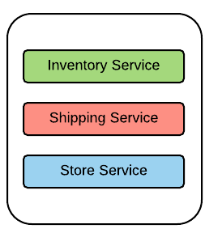
Monolithic Architecture
Use case : Online Retail software application with which comprises of multiple business functionalities.
*

Slide 6
Monolithic Architecture
Developed and deployed as a single unit.
Overwhelmingly complex; which leads to nightmares in maintaining, upgrading and adding new features.
Redeploy the entire application, in order to update a part of it.
Scaling : scaled as a single application and difficult to scale with conflicting resource requirements
Reliability - One unstable service can bring the whole application down.
Hard to innovate, practice agile development and delivery methodologies
*

Slide 7

‘Microservices’ Architecture
*

Slide 8
Microservices Architecture
The foundation of microservices architecture(MSA) is about developing a single application as a suite of fine-grained and independent services that are running in its own process, developed and deployed independentlyග
Its just more than segregating the services in a monolith.
*

Slide 9
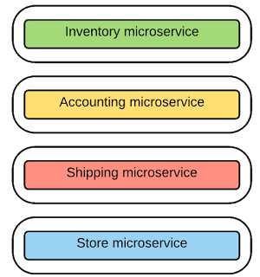
Microservices Architecture
Use case : Online retail application can be implemented
with a suite of microservices
*

Slide 10

Designing Microservices : Size, scope and capabilities
Common Misconceptions
Lines of Code
Team size
'Micro' is a bit misleading term
Use web services and rebranding them as microservices
*

Slide 11
Designing Microservices : Size, scope and capabilities
Single Responsibility Principle(SRP): Having a limited and a focused business scope.
Find the service boundaries and align them with the business capabilities .
Make sure the microservices design ensures the agile/independent development and deployment of the service.
Focus on scope of the microservice, but not about making the the service smaller- righted sized services
Unlike service in web services, a given microservice should have a very few operations/functionalities and simple message format.
Start with relatively broad service boundaries to begin with, refactoring to smaller ones (based on business requirements) as time goes on.
*

Slide 12
Messaging in Microservices
In Monolithic architecture:
Function calls or language-level method calls
SOA/web services : SOAP and WS* with HTTP, JMS etc.
Webservices with several dozens of operations and complex message schemas
In Microservice architecture:
Simple and lightweight messaging mechanism.
*

Slide 13
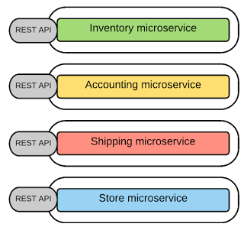
Messaging in Microservices
Synchronous Messaging
Client expects a timely response from the service and waits till it get it.
REST, Thrift
*

Slide 14
Messaging in Microservices
Asynchronous Messaging
Client doesn't expects a response immediately, or not accepts a response at all
AMQP, STOMP, MQTT
Message Formats
JSON, XML, Thrift, ProtoBuf, Avro
Service Contracts
Defining the service interfaces - Swagger, RAML, Thrift IDL
*

Slide 15
Integrating Microservices (Inter-service Communication)
Required to have the communication structures between different microservices.
SOA/web services used ESB.
Microservices promotes to eliminate the central message bus/ESB and move the 'smart-ness' or business logic to the services and client(known as 'Smart Endpoints').
Connect services through ‘dumb’ pipes.
*

Slide 16
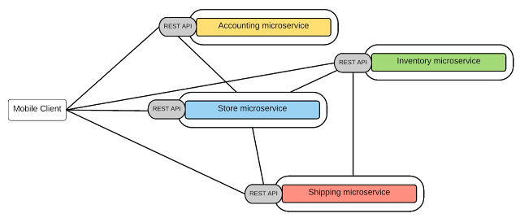
Integrating Microservices (Inter-service Communication)
Point-to-point style - Invoking services directly
*

Slide 17
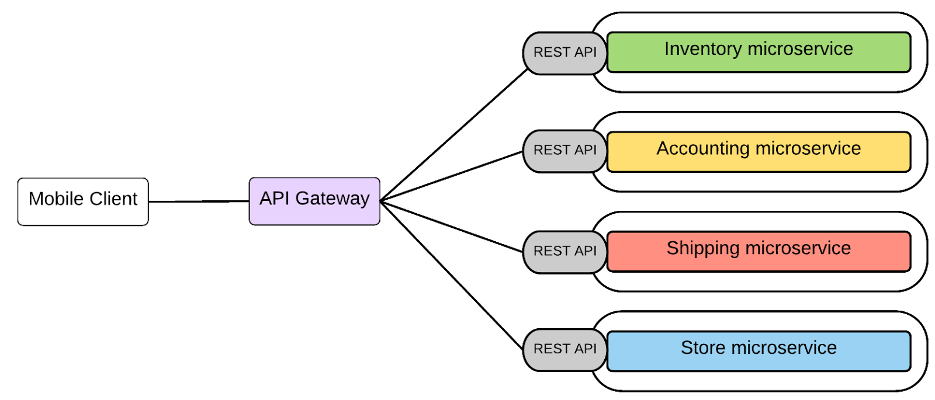
Integrating Microservices (Inter-service Communication)
API-Gateway style
*

Slide 18
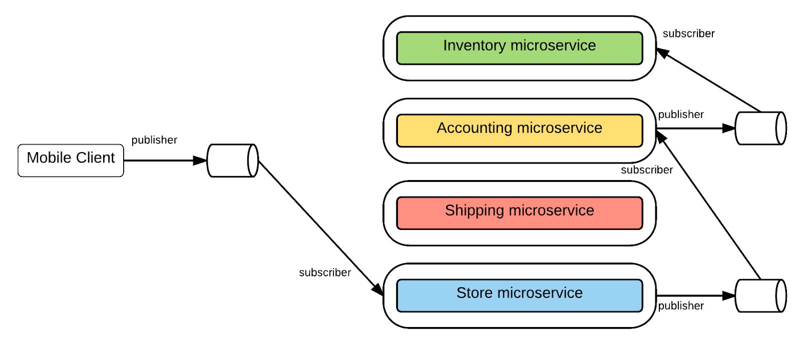
Integrating Microservices (Inter-service Communication)
Message Broker style
*

Slide 19
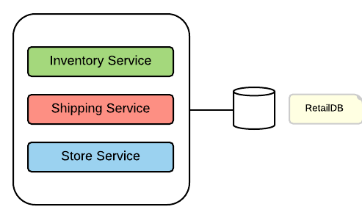
Data Management
Monolithic applications use a centralized database
*

Slide 20
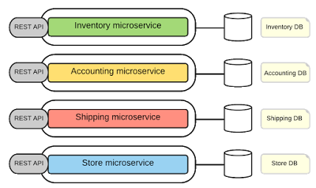
Data Management
Decentralized Data manangement with Microservices
*

Slide 21
Data Management
Decentralized Data manangement with Microservices
Each microservice can have a private database to persist the data that requires to implement the business functionality offered from it.
A given microservice can only access the dedicated private database but not the databases of other microservices.
In some business scenarios, you might have to update several database for a single transaction. In such scenarios, the databases of other microservices should be updated through its service API only
*

Slide 22
Decentralized Governance
Governance - establishing and enforcing how people and solutions work together to achieve organizational objectives
Design and runtime governance.
In Microservices Architecture:
No centralized design-time governance.
Make their own decisions about its design and implementation.
Foster the sharing of common/reusable services.
Run-time governance aspects such as SLAs, throttling, monitoring, common security requirements and service discovery may be implemented at API-GW level.
*

Slide 23
Service Registry and Service Discovery
Service Registry - Holds the microservices instances and their locations
Service Discovery - find the available microservices and their location
*

Slide 24
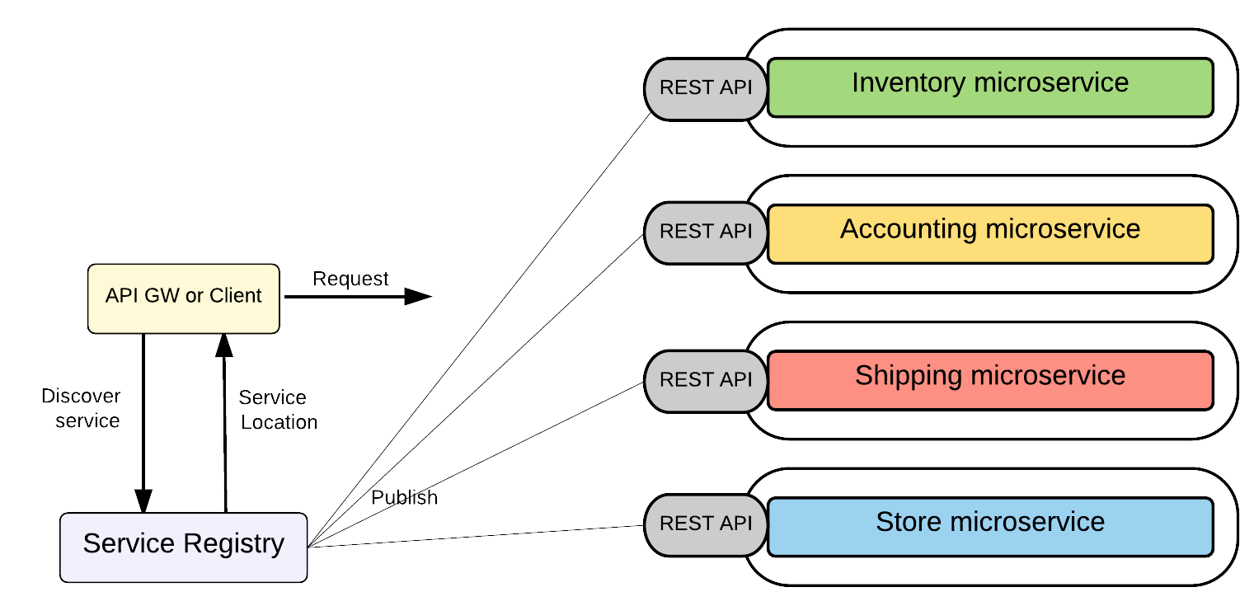
Service Discovery
Client-side Discovery
*

Slide 25
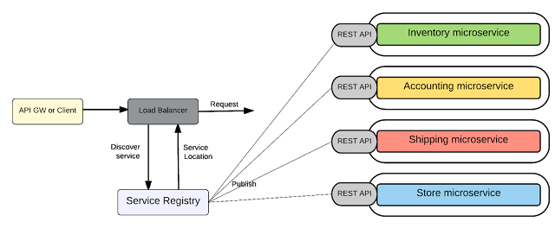
Service Discovery
Server-side Discovery
*

Slide 26
Microservice Deployment
Ability to deploy/un-deploy independently of other microservices.
Must be able to scale at each microservices level.
Building and deploying microservices quickly.
Failure in one microservice must not affect any of the other services.
*

Slide 27

Microservice Deployment
Docker
Docker is becoming an extremely popular way of packaging and deploying services.
Package the microservice as a (Docker) container image.
Deploy each service instance as a container.
Scaling is done based on changing the number of container instances.
Building, deploying and starting microservice will be much faster as we are using docker containers
*

Slide 28
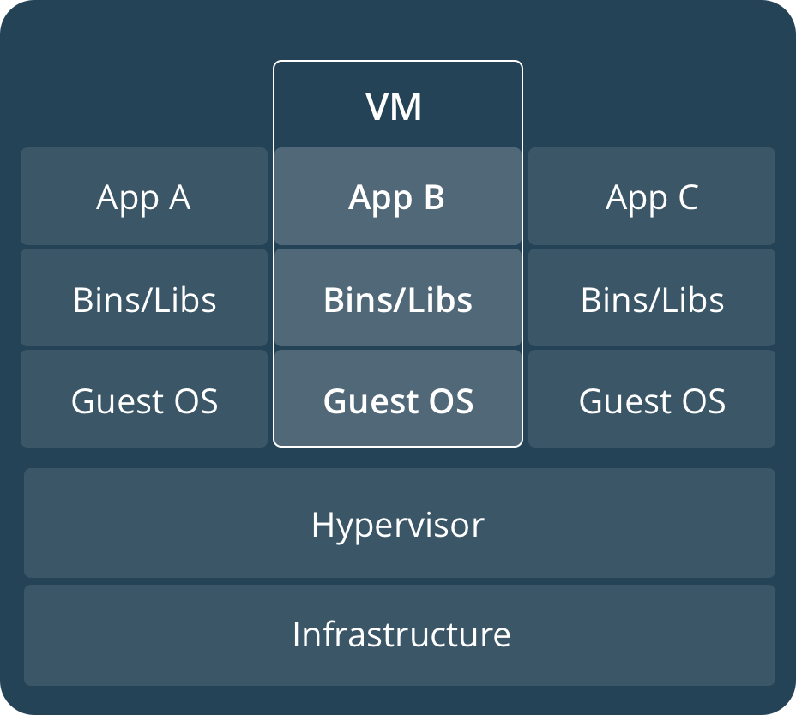
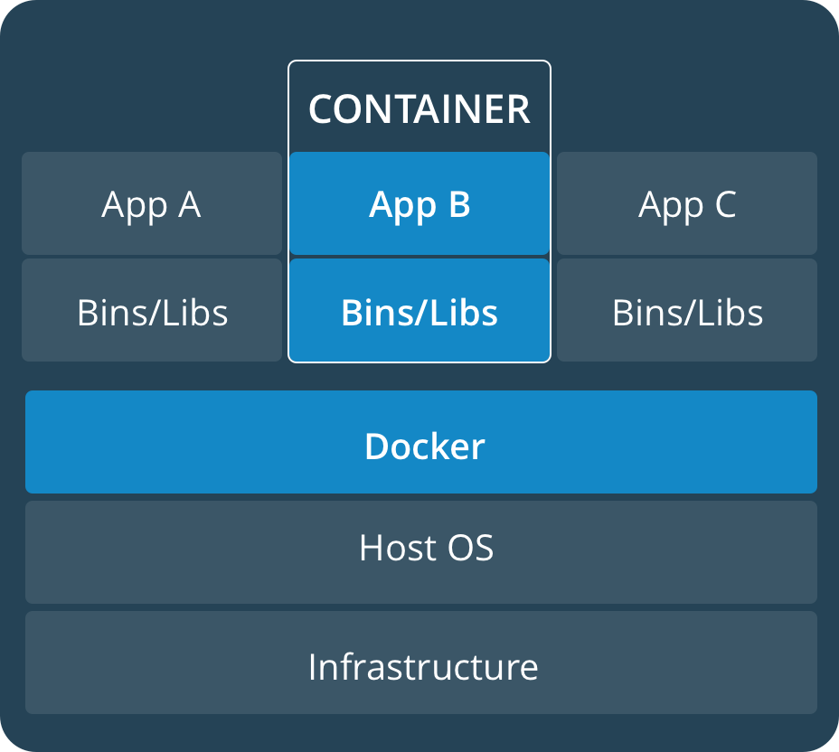
Virtual Machines Vs. Docker
*

Slide 29

Microservice Deployment
Kubernetes
Extending Docker's capabilities by allowing to manage a cluster of Linux containers as a single system, managing and running Docker containers across multiple hosts, offering co-location of containers, service discovery and replication control.
*

Slide 30
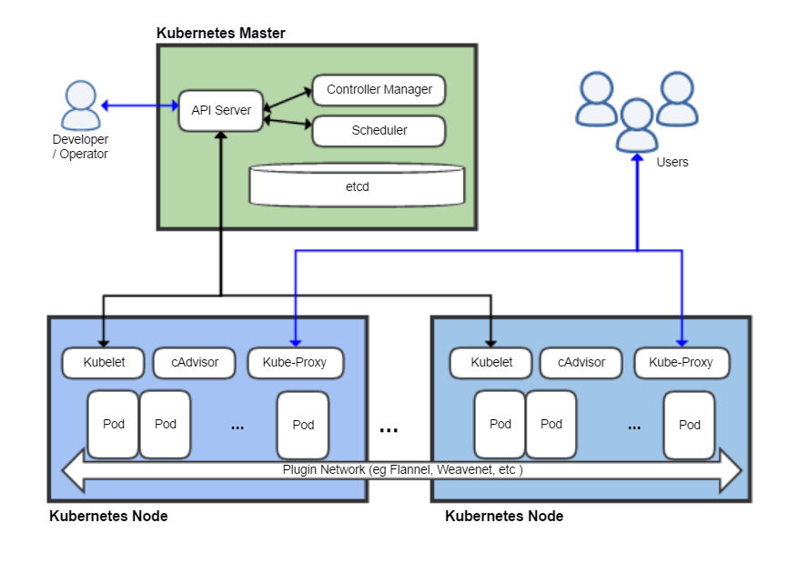
Kubernetes
*

Slide 31
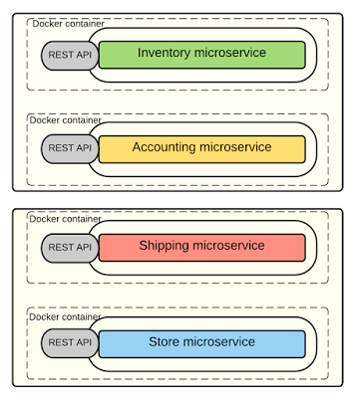
Microservice Deployment
Use case : The microservices of Online Retail software application with can be deployed and scaled with Docker and Kubernetes.
*

Slide 32
Security with Microservice
Security in Monolithic applications
Its about 'who is the caller', 'what can the caller do' and 'how do we propagate that information'.
Often implemented at a common security component which is at the beginning of the request handling chain and that component populates the required information with the use of an underlying user repository
Security in Microservices
a security component implemented at each microservice’s level that uses a central user repository/store.
Leverage the widely used API-Security standards such as OAuth2 and OpenID Connect
*

Slide 33

Security with Microservice
OAuth 2.0
The client authenticates with authorization server and get an opaque token which is known as 'Access token'. Access token has zero information about the user/client.
It only has a reference to the user information that can only be retrieved by the Authorization server. Hence this is known as a 'by-reference token' and it is safe to use this token even in the public network/internet.
*

Slide 34
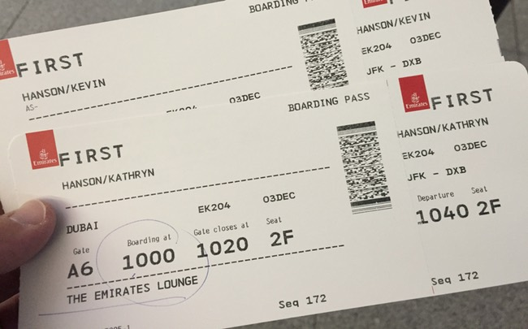
Security with Microservice
OpenID Connect
OpenID Connect behaves similar to OAuth but in addition to the Access token, the authorization server issues an ID token which contains information about the user.
Implement with a JWT (JSON Web Token) and that is signed by authorization server. So, this ensures the trust between the authorization server and the client.
JWT token is therefore known as a 'By-value token' as it contains the information of the user and obviously it is not safe to use it outside the internal network.
*

Slide 35
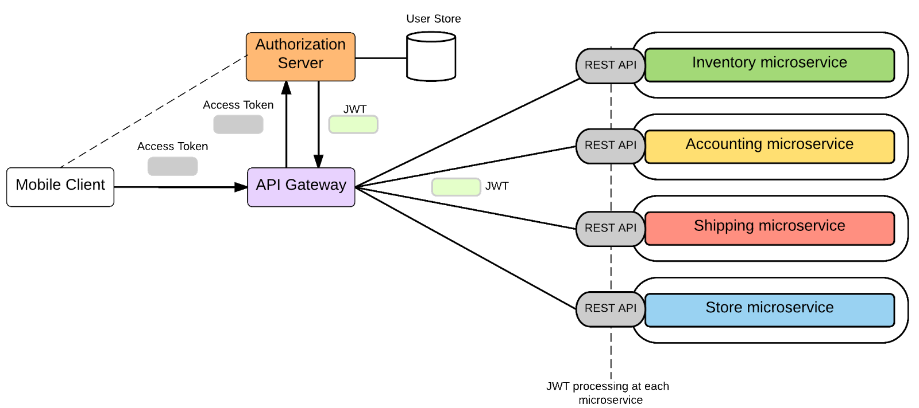
Security with Microservice
Microservice security with OAuth2 and OpenID Connect
*

Slide 36
Transactions
Supporting distributed transactions across multiple microservices – Too complex.
Microservice architecture itself encourages the transaction-less coordination between services.
Mandatory transaction requirements can be fulfilled with 'compensating operations'
*

Slide 37
Design for Failures
Increases the possibility of having failures at each service level
Unavailable or unresponsive microservice should not bring the whole system down
Microservices should be fault tolerant, be able to recover when that is possible and the client has to handle it gracefully.
Error handling patterns
Circuit Breaker
Timeout
Bulkhead
*

Slide 38
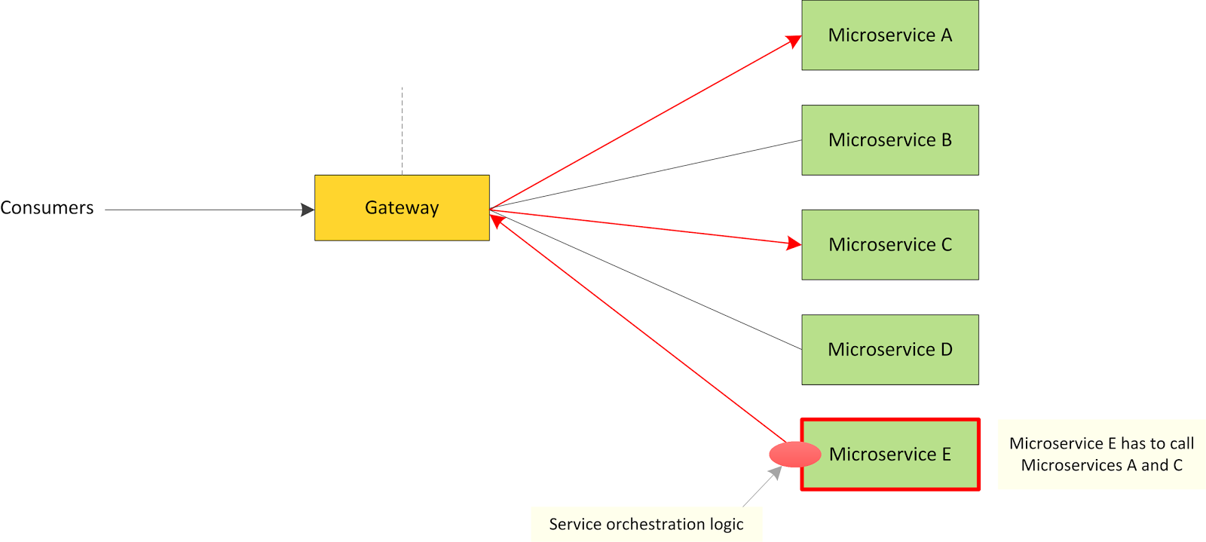
Orchestrating Microservices
Orchestration at Microservices Layer
*

Slide 39
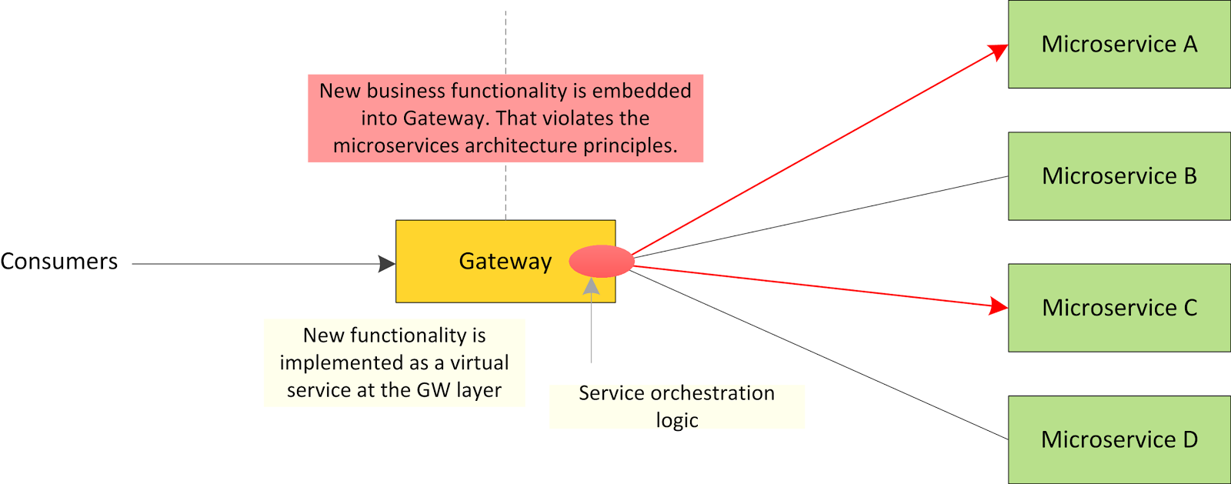
Orchestrating Microservices
Orchestration at the Gateway Layer
*

Slide 40
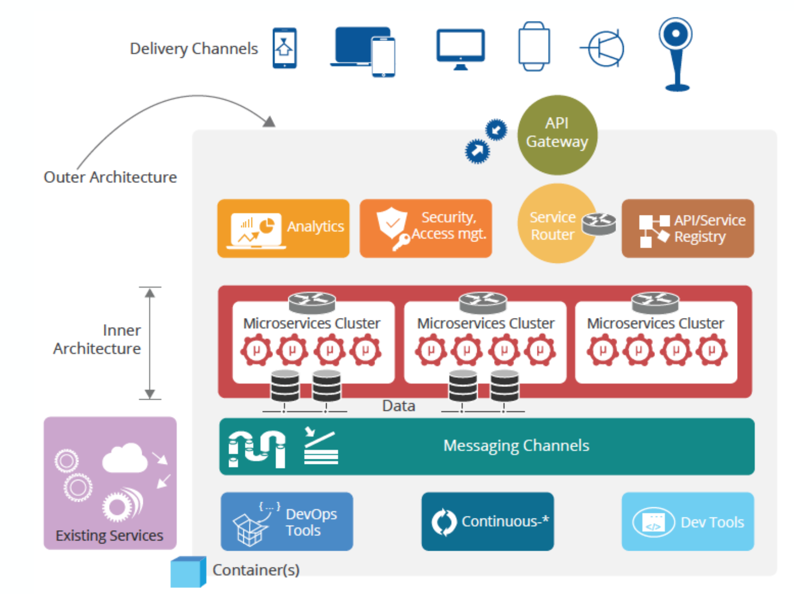
Microservices in Modern Enterprises
Inner and Outer Architecture
*

Slide 41
Microservices in Modern Enterprises
Inner and Outer Architecture
Inner Architecture : The pure microservices components which is less complex are categorized under 'Inner Architecture'
Outer Architecture : This delivers the platform capabilities that are required to build a solution around the microservices that we build.
*

Slide 42
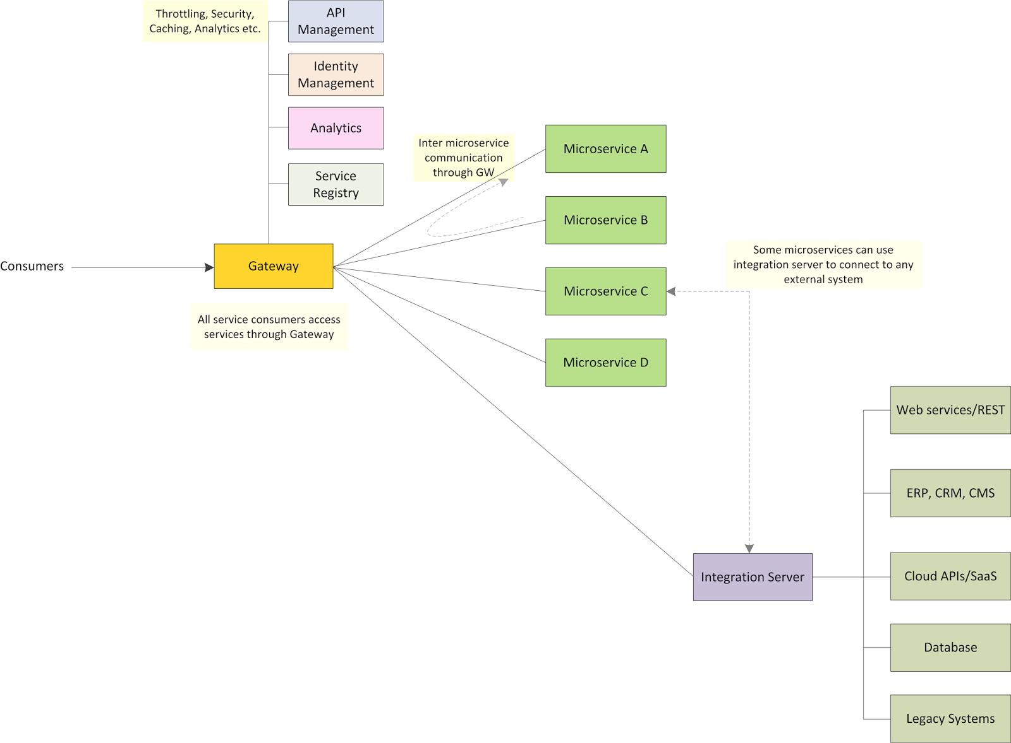
Microservices in Modern Enterprises
Modern Enterprise Architecture with Microservices, Enterprise Integration and API Management
*

Slide 43
Microservices – Conclusion
Microservices is not a panacea : It won't solve all your enterprise IT needs
‘SOA done right’?
Most enterprise won't be able to convert their entire enterprise IT systems to microservices.
Enterprise Integration never goes away.
Microservices are exposed as APIs.
Interaction between microservices should be support via a lightweight orchestration engine/Gateway or inside another microservice.
*

Slide 44
References
http://kasunpanorama.blogspot.com/2015/11/microservices-in-practice.html
http://kasunpanorama.blogspot.com/2016/02/microservices-enterprise-integration.html
http://microservices.io/patterns/
http://martinfowler.com/microservices/
*

